Slide 1

Lager Yeast Strains & Temperature Impact
A DRAFT Homebrew Club Presentation

Slide 2
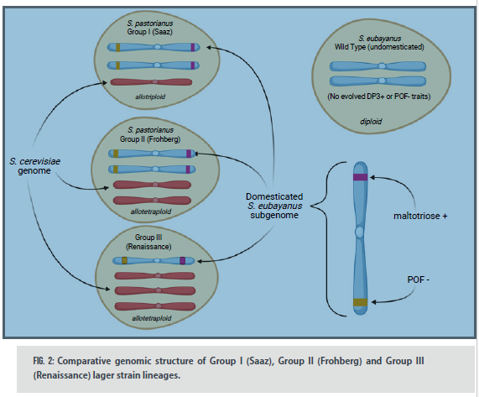
Genetic Origins of Lager Yeast
Lager yeasts are classified by genomic lineage
All Saccharomyces pastorianus strains contain genetics from:
  S. cerevisiae (ale yeast)
  S. eubayanus (cold-tolerant wild yeast)
Traditional lager groups formed through natural hybridization

Slide 3
Group I (Saaz) Lager Strains
Allotriploid with 3 chromosome sets
Greater S. eubayanus contribution
More cold tolerant (cryotolerant)
Excellent for traditional cold-fermented lagers
Associated with classic Czech lager brewing

Slide 4
Group II (Frohberg) Lager Strains
Allotetraploid with 4 chromosome sets
Greater S. cerevisiae contribution
Broader temperature and alcohol tolerance
Stronger fermentation performance
Includes 34/70 and LalBrew Diamond™

Slide 5
Group III Renaissance Strains
CreateGroup III 'Renaissance' strains are modern hybrids created using classical and non-GMO breeding methods
Represents the first major lager yeast innovation in centuries
Greater S. cerevisiae contribution improves fermentation speed
Retains cryotolerance from S. eubayanus genetics
Characteristics:
  Warm temperature tolerance
  Rapid and robust fermentation
  Low diacetyl and H₂S production
  Clean modern lager flavor profile

Slide 6
Major Lager Yeast Families
(Common Names)
German/Bavarian: clean, crisp, balanced
Czech/Bohemian: rich malt and soft bitterness
Munich: elegant malt-forward profile
American: neutral and highly drinkable
Hybrid strains: warmer fermentation capable
Modern strains: fast turnaround and low sulfur

Slide 7
Popular Lager Yeast Strains
W-34/70 – versatile German workhorse
Diamond Lager – clean modern dry strain
2278 Czech Pils – rounded malt profile
2308 Munich Lager – smooth and rich
WLP840 American Lager – neutral and crisp
NovaLager – rapid fermentation with low sulfur

Slide 8
Lager Strain Characteristics
Strain | Type | Characteristics | Best Styles
W-34/70 | German | Clean, versatile | Pilsner, Helles
Diamond | Modern Dry | Fast, crisp | Modern Lager
2278 Czech | Czech | Malty, rounded | Czech Pils
2308 Munich | Munich | Rich malt | Dunkel, Bock
WLP840 | American | Neutral, dry | American Lager
NovaLager | Hybrid | Low sulfur | Fast Lager

Slide 9
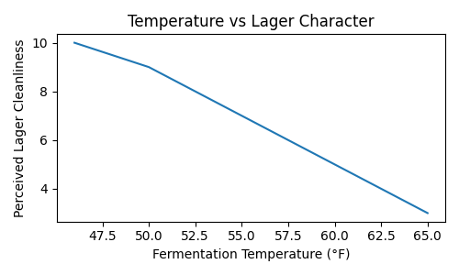
Why Fermentation Temperature Matters
Temperature controls ester production
Impacts sulfur compounds and diacetyl
Changes attenuation and mouthfeel
Influences fermentation speed
Shapes overall lager flavor profile

Slide 10
Classic Lager Temperature Zones
44–48°F: very clean and crisp
48–52°F: classic traditional lager range
52–58°F: faster with slight ester increase
58–65°F: warm lager or pseudo-lager territory

Slide 11
Biggest Misconception
“Colder always equals cleaner.” - Not always; too cold can cause:
  stalled fermentation
  excess sulfur
  incomplete attenuation
  yeast stress
Healthy lager fermentation depends on balancing:pitch rate, oxygen,temperature,yeast strain selection all together

Slide 12
Cold Fermentation Effects
Cleaner beer with fewer esters
Sharper hop expression
Longer fermentation timeline
More sulfur production
Excellent for German-style lagers

Slide 13
Warm Lager Fermentation
Faster fermentation and turnaround
Softer mouthfeel and fuller perception
Reduced sulfur retention
Possible pear or apple esters
Common in modern craft brewing

Slide 14
Classic Lager Fermentation Curve
Pitch at 44–48°F
Ferment at 48–50°F
Raise to 60°F near terminal gravity
Hold 2–3 days for diacetyl cleanup
Slowly cool to lagering temps
Lager at 32–36°F for weeks

Slide 15
Pressure Fermentation Overview
Typically performed in sealed fermenters at 5–15 PSI at at 58–65°F
Pressure fermentation traps CO₂ during active fermentation
Suppresses ester and fusel alcohol production
Cleaner fermentation at warmer temperatures
Can reduce sulfur expression in lager yeast strains
Speeds up fermentation and lager turnaround time
Produces clean, crisp beer with reduced conditioning time
Commonly used with strains like W-34/70 and NovaLager™
Excellent method for homebrewers with limited cooling capacity

Slide 16

Key Takeaways
Yeast strain selection strongly affects lager character
Temperature dramatically changes fermentation outcome
Cold fermentation creates classic crisp lagers
Modern strains offer greater flexibility
Healthy yeast and good temperature control are essential

Slide 17
Previous Experiment #1
Warm Pressure-Fermented German Pils
Compared traditional cold lager fermentation vs warm pressure fermentation
Warm-fermented lager remained surprisingly clean
Blind tasters struggled to reliably distinguish the beers
Pressure suppressed ester and fusel alcohol production
Supports fast modern lager brewing methods

Slide 18
Previous Experiment #2
Festbier Pressure Fermentation
Tested warm pressure fermentation on a Festbier
Warm fermentation significantly reduced production time
Beer retained traditional lager-like character
Minimal sensory differences detected in blind tasting
Demonstrated effectiveness of pressure fermentation for lagers

Slide 19
Previous Experiment #3
Lager Fermentation
Cold fermentation reduced ester and phenol production
Produced classic crisp and clean lager profile
Enhanced hop sharpness and drinkability
Required longer fermentation and conditioning time
Confirmed benefits of traditional lager temperatures

Slide 20
Prevoius Experiment #4
Fermentation Temperature & Flavor Chemistry
Journal studies showed temperature changes volatile compounds
Higher temperatures increased fruity esters
Lower temperatures created cleaner flavor profiles
Temperature strongly influenced aroma and mouthfeel
Yeast strain selection amplified these effects

Slide 21
Prevous Experiment #5
Stable vs Variable Fermentation Temperatures
Compared stable fermentation temperatures to fluctuating temperatures
Stable temperatures improved beer consistency
Temperature swings stressed yeast performance
Stable fermentation reduced off-flavor risk
Consistent temperature control is critical for clean lagers

Slide 22
Prevous Experiment #6
DRAFT Experiment
Lager Pressure fermentation

Slide 23
Brainstorm- Club Experiment Proposal
Use Modern Lager and Traditional Yeast
Two different temperature profiles and Pressure
  Traditional “cold” Lager Fermentation
  Warm Fermentation
  Pressure fermentation
Ask WG to provide wort – common baseline
Requires accurate ferment temp control setups

